Slide 1

BANKING CUSTOMER & LOAN PREDICTION SYSTEM
Dept. Of Computer Science & Engineering
Rajiv Gandhi University
Under the Supervision & Guidance of
Prof. Utpal Bhattacharjee
Professor Dept. of CSE
PRESENTED BY:
PRANAB BORA
MCA 6TH SEMESTER
18MCA012

Slide 2
Contents
Introduction
Objective
Neural Network
System Requirements
Python Libraries
Dataset
Neural Network Implementation
End to end implementation with flask
Web Based System UI in Flask
Reference

Slide 3
Introduction
Banking Customer and Loan Prediction System is a system that can be used by bank employee to verify with the previous loan applicants data and whether the application was approved or not for the current customer.
In this project , we will build a machine learning model to predict the loan approval probability.

Slide 4
Objective
We have the dataset for loan application information like the applicant's name, personal details, financial information and requested loan amount and related details and the outcome (whether the application was approved or rejected).
Based on this we are going to train a model with neural network and predict if a loan will get approved or not.

Slide 5
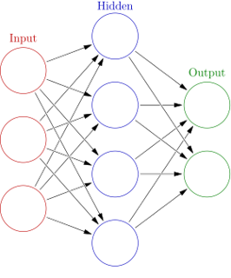
Neural Network
A neural network is a series of algorithms that endeavors to recognize underlying relationships in a set of data through a process that mimics the way the human brain operates.
A neural network contains layers of interconnected nodes.
In this project, we will use artificial neural network(ANN).

Slide 6
Artificial Neural Network(ANN)
One of the most influential technologies of the decade is artificial neural networks.
It is the fundamental piece of deep learning algorithms.
The core component of ANNs is artificial neurons.
Each neuron receives inputs from several other neurons, multiplies them by assigned weights, adds them and passes the sum to one or more neurons.
Artificial neural networks are composed of an input layer, which receives data from outside sources (data files, images, hardware sensors, microphone…), one or more hidden layers that process the data, and an output layer that provides one or more data points based on the function of the network

Slide 7
System Requirements
Operating System :
Windows/Linux/MacOS (Support)
Hardware :
Processor : Intel i5 , Ryzen3 etc
Ram : 8GB
ROM : HDD or SSD(Provide processing speed)
Graphics card : Required (else it will take more time to execute)
Software :
Python
Anaconda navigator (Jupyter notebook / Spyder)
Or Google Colab
Intellij Idea Ultimate
CUDA

Slide 8
Python Libraries
Numpy​
NumPy is a Python library used for working with arrays. It also has functions for working in domain of linear algebra, fourier transform, and matrices.
Pandas​
Pandas is mainly used for data analysis. Pandas allows importing data from various file formats such as JSON, SQL, Microsoft Excel.
Matplotlib​
matplotlib.pyplot is a collection of functions that make matplotlib work like MATLAB.
Scikit-learn​
The sklearn library contains a lot of efficient tools for machine learning and statistical modeling including classification, regression, clustering and dimensionality reduction.
Keras ​
Keras is the most used deep learning framework, it offers consistent & simple APIs, it minimizes the number of user actions required for common use cases, and it provides clear & actionable error messages.
Tensorflow ​
TensorFlow is an end-to-end open source platform for machine learning. It has a comprehensive, flexible ecosystem of tools, libraries and community resources
Flask
Flask is a popular Python web framework, meaning it is a third-party Python library used for developing web applications.

Slide 9
Dataset
https://www.kaggle.com/omkar5/dataset-for-bank-loan-prediction
Dataset have approximately 700 users data.

Slide 10
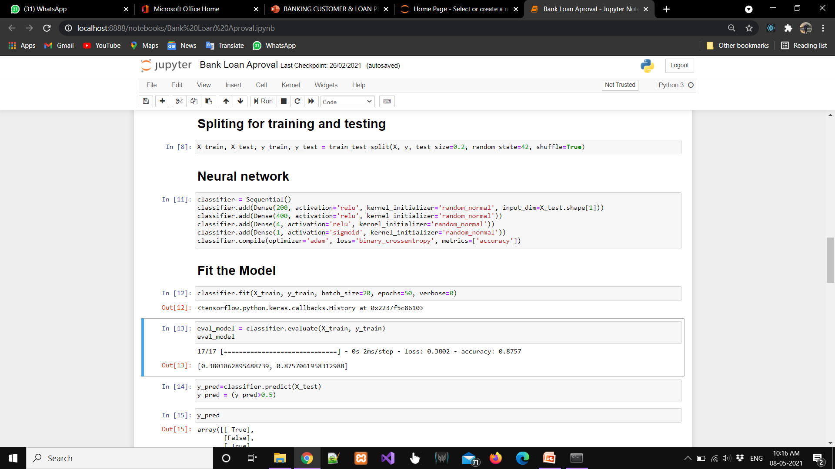
Neural Network Implementation

Slide 11
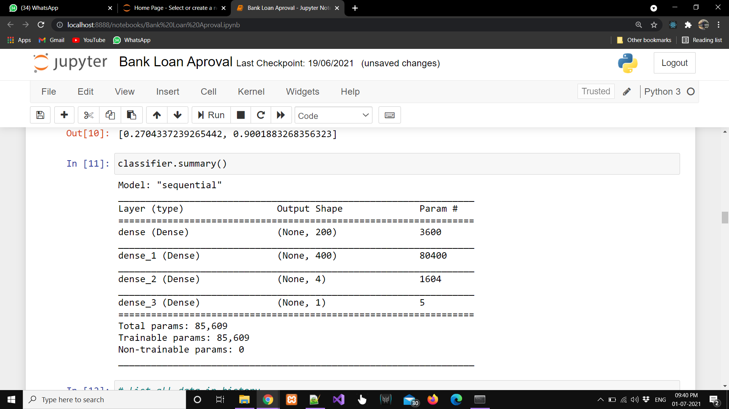
Model Summery

Slide 12
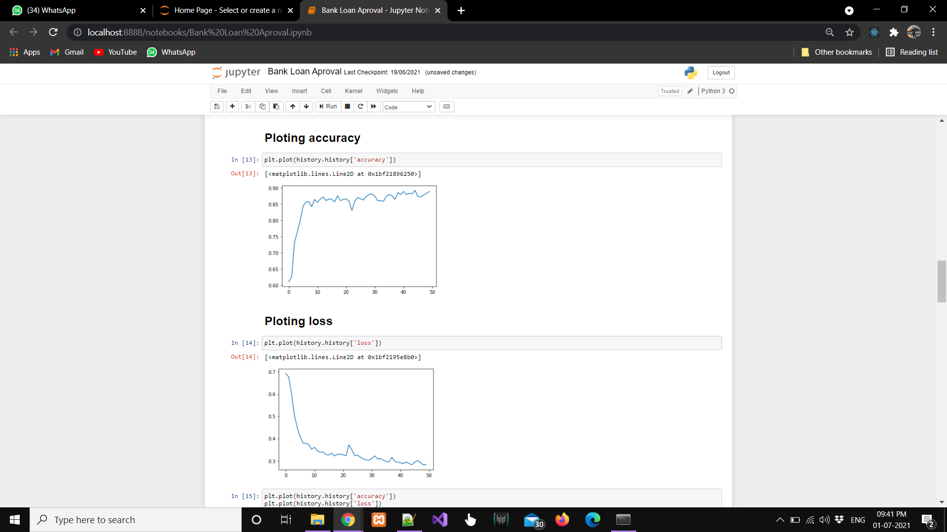
Plotting accuracy and loss

Slide 13
End-to-end Implementation with Flask
Flask is a lightweight Web Server Gateway Interface(WSGI) web application framework.
It is designed to make getting started quick and easy, with the ability to scale up to complex applications.
It began as a simple wrapper around Werkzeug and Jinja and has become one of the most popular Python web application frameworks.
Werkzeug is a comprehensive WSGI web application library.
Jinja2 is one of the most used template engines for Python.

Slide 14
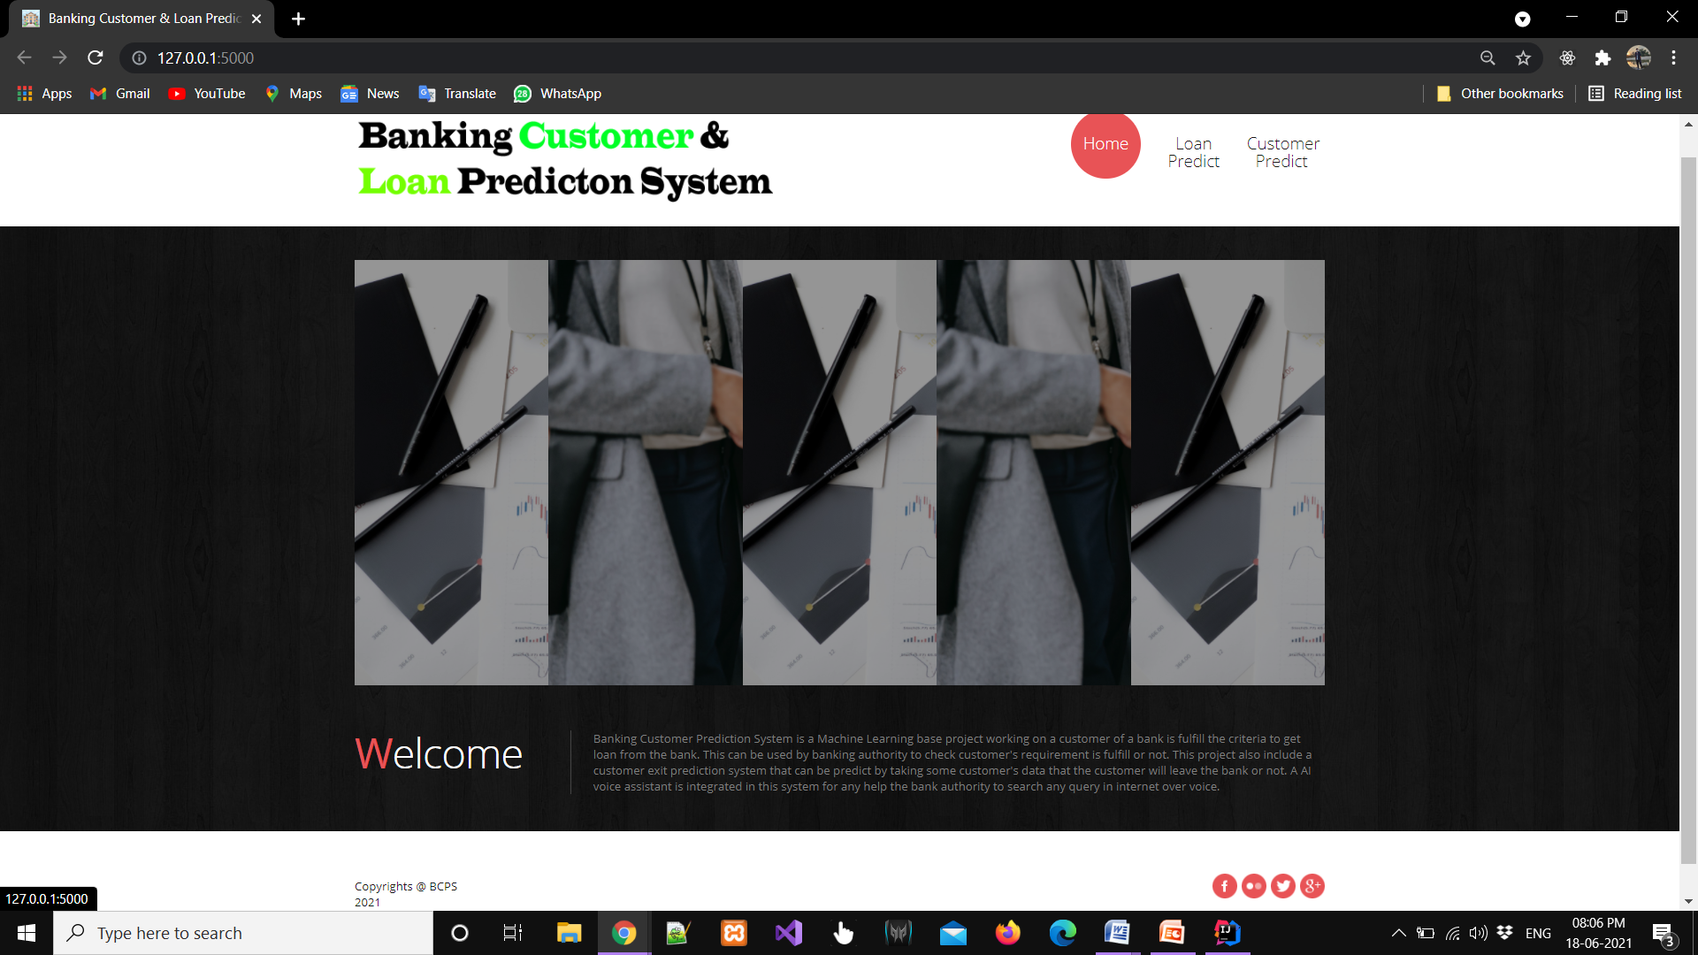
Web based system UI in Flask

Slide 15
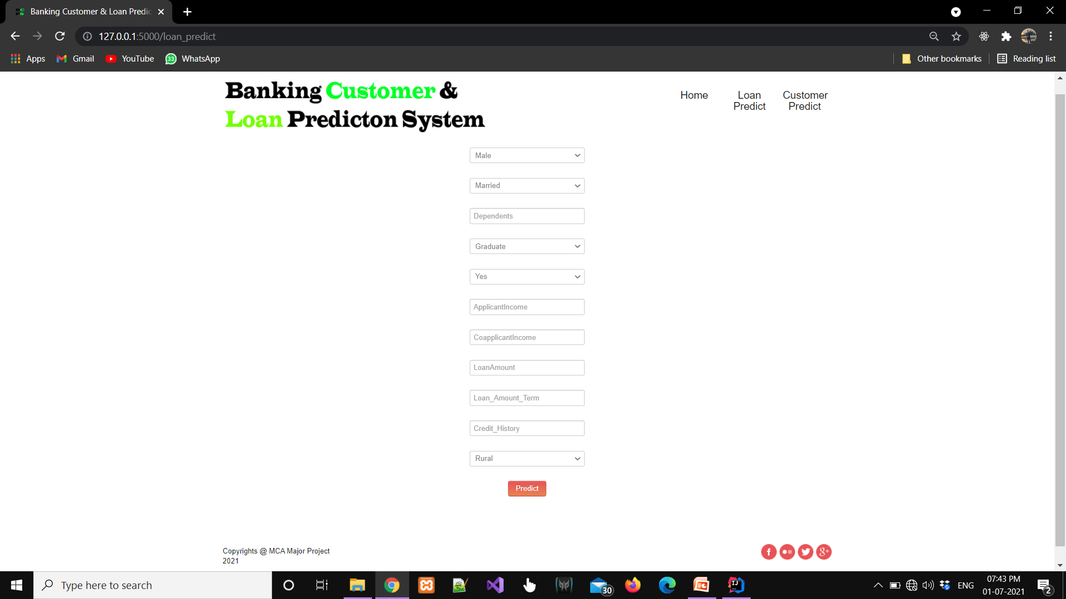
Prediction form in Flask UI

Slide 16
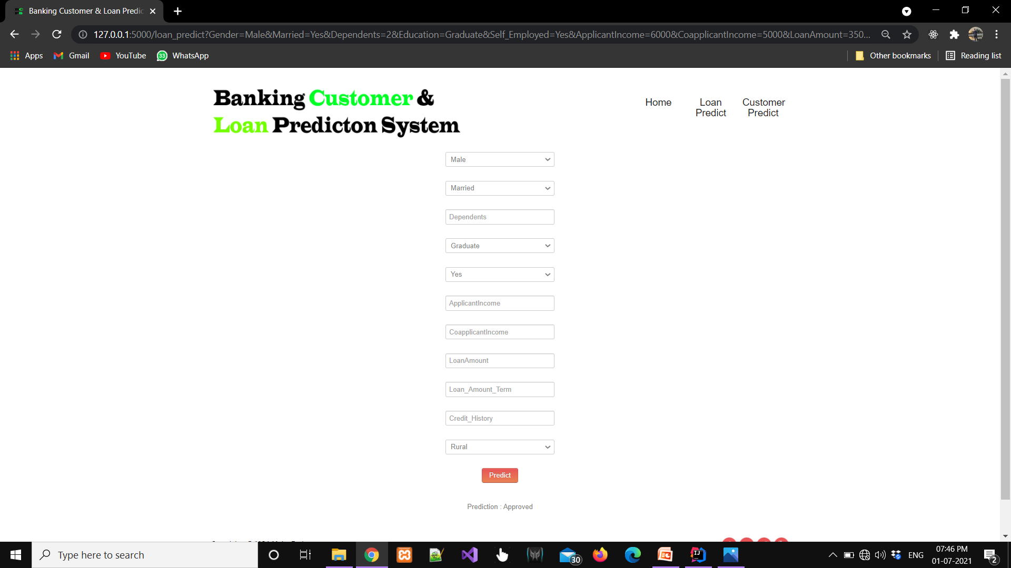
Predicted Result

Slide 17
Reference
Rattle data mining tool: available from http://rattle.togaware.com/rattle-download.html
Ekta Gandotra, Divya Bansal, Sanjeev Sofat 2014, ‘Malware Analysis and Classification: A Survey’available from http:// www.scirp.org/journal/jis
J. R. Quinlan. Induction of Decision Tree. Machine Learning, Vol. 1, No. 1. pp. 81-106., 1086.
Mean Decrease Accuracy https://dinsdalelab.sdsu.edu/metag.stats/code/randomforest.hml
J.R. Quinlan. Induction of decision trees. MachinelearningSpringer, 1(1):81–106, 1086.
Andy Liaw and Matthew Wiener. Classification and Regression by randomForest. R News( http://CRAN.R-project.org/doc/Rnews/ ), 2(3):9–22, 2002.

Slide 18


